Slide 1



















KYTC D-3 Incident Mgt Meeting
2014 1st Quarter
February 11th, 2013

Slide 2
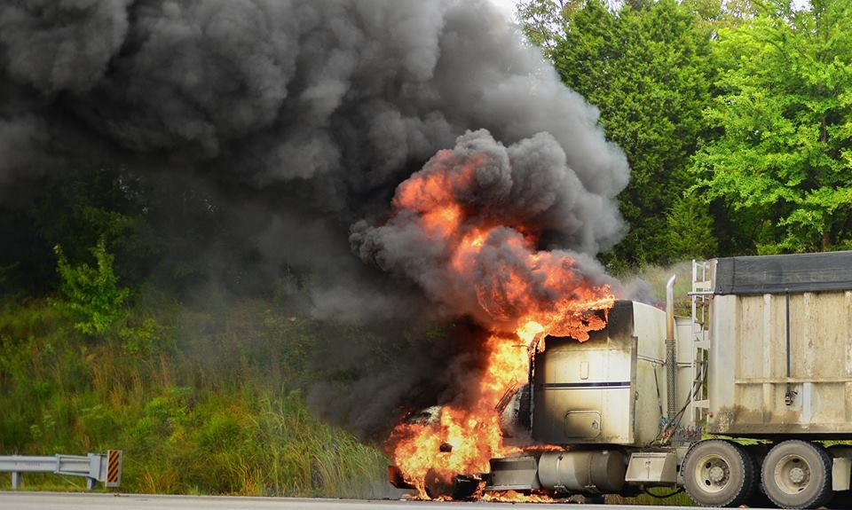
Welcome / Introductions

Slide 3
Agenda
Review of recent incidents
Issues or concerns open from 2013
Non-emergency lane closures for cleanup
KYTC D-3 Interstate / Parkway Emergency Plan
Construction project updates
2014 Goals and planning

Slide 4
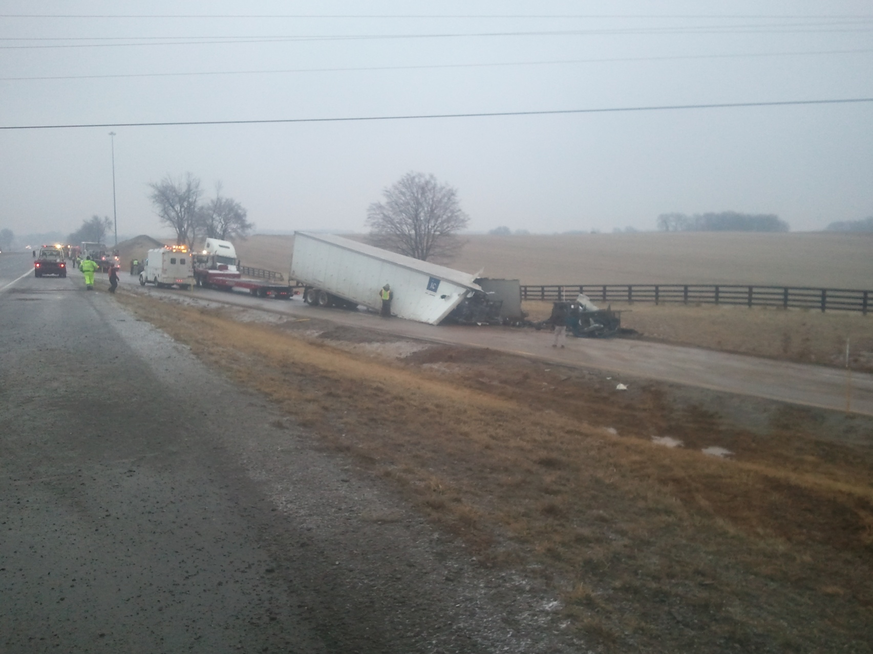
Recent Incidents
Feb. 3rd NB I-65 @ 6 mm Simpson Co

Slide 5
Feb. 3rd NB I-65 @ 6 mm Simpson Co
Icy conditions on bridge
  0646 Post 3 reports to TOC 3 lanes blocked, 5 hrs est.blockage.
  Multi vehicle accident, several semi-trucks
  0655 TOC notification e-mail sent to Central dist. List
  0805 3 NB lanes cleared, TOC advised. Ramp still blocked
  Cleared
Simpson Co SO, CVE, FSFD, KYTC & at least 3 tow companies on-scene
Ramp blocked by broken trailer & loose cargo (truck parts) that had to be unloaded & picked up.
Good job clearing wreckage to NB shoulder ASAP.

Slide 6
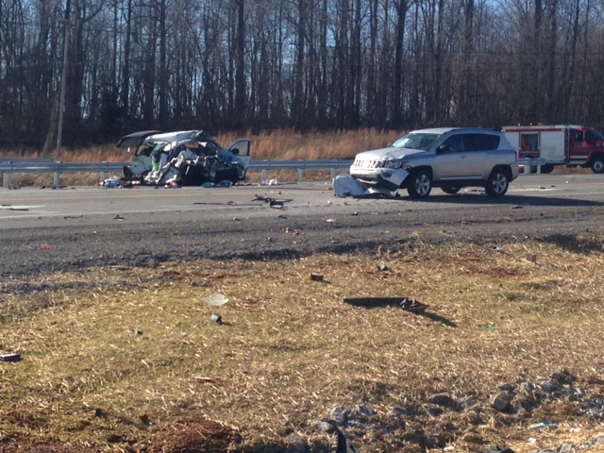
KY90 / KY163 Metcalfe Co.
Jan. 12th, 2014 approx. 9:45 am

Slide 7
2014 IM Team Goals
?
?
?
IM Team Mission Statement

Slide 8
Issues / Concerns from 2013
KYTC role in incident planning & response
TOC notification by initial responders
SAFE Patrol operators needed upstream of incident at start of traffic queue
“Hold harmless” legislation to allow KYTC assets to assist with cleanup.
“Post-Emergency” cleanup & traffic control

Slide 9
KYTC – Our role
Preliminary ……
Coordinate inter-agency District IM Team
Develop plan & tools to maintain safe flow of traffic in major closure incidents.
Assist local emergency responders with initial traffic control as resources permit.
Assume traffic control for large scale or long-term incidents.
Provide equipment resources as requested to assist in incident stabilization / mitigation.

Slide 10


TOC Notification
502 564 2080
Any partial or complete closure of major roadway
Law enforcement agency or initial incident commander notifies
Conservative estimate of duration
TOC notifies KYTC resources
Remember to terminate incident with TOC

Slide 11
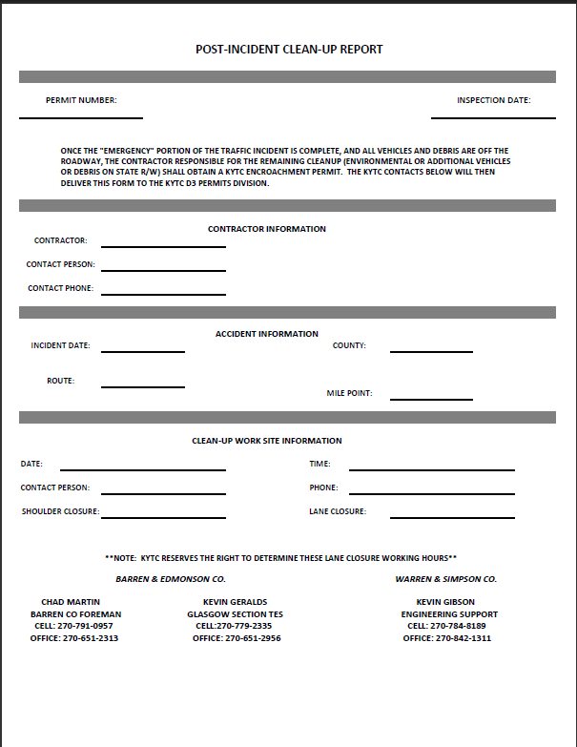
Post-Emergency Clean Up
After emergency phase is complete / traffic flowing
Non-emergency recovery, cleanup or remediation
Permit to be obtained from KYTC
Contractor responsible for traffic control

Slide 12


Traffic Control Resources
Area Wide Protective
Knoxville TN
800-343-2650
www.awptrafficsafety.com
Highway Safety Services Inc.
Louisville KY
502-366-5602
www.highwaysafetyequipment.com
Saf-Ti-Co
Louisville KY
502-772-2511
www.saftico.com
RoadSafe Traffic Systems
LaVergne TN
615-287-0900
www.roadsafetraffic.com
*This is not a recommendation or endorsement of any provider*

Slide 13
Interstate / Parkway Emergency Plan
Goal
1. Designate and document, in advance, alternate routes and response plan
2. Implement tools to communicate plan to responders and traveling public
3. Identify agencies / crews responsible for implementing plan in emergency responses
Everyone has a plan & is on the same plan

Slide 14
Interstate / Parkway Emergency Plan
Planned results -
Route maps – primary & secondary
Route signage – combination of permanent alternate and pre-placed flip-down detour type
Control points for diversion & access closure
Standardized setup for diversion traffic control
Pre-loaded message packages for electronic message boards for rapid activation
Assignments for implementing & deactivating deployments.

Slide 15
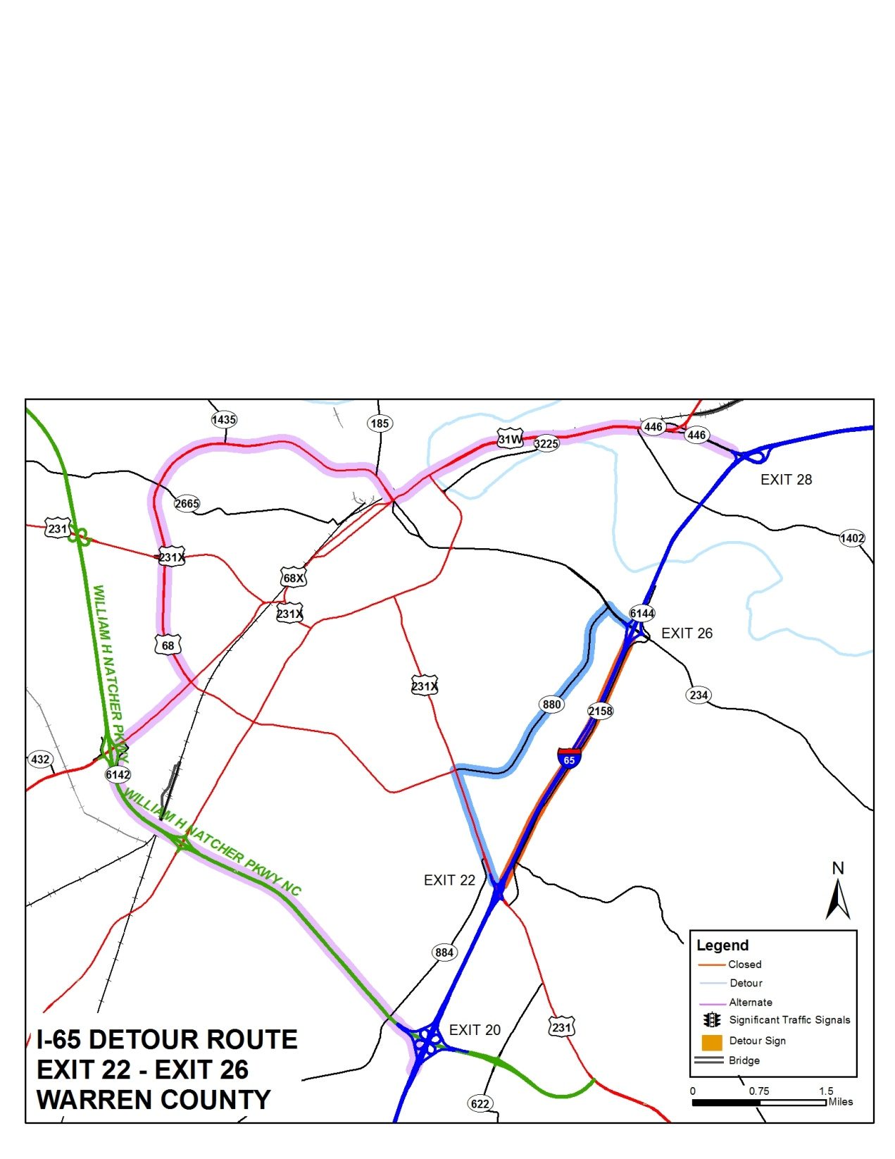


Detour Maps
Detour Route Base Map Example
I65 22-26 mm

Slide 16
Emergency Plan
Emergency contacts – KYTC and emergency response agencies
Detour route
Closure / diversion points
DMS messages preloaded
Detour signs to deploy
Critical traffic signals
Additional information

Slide 18
Interstate / Parkway Emergency Plan
Current status > I-65 0.0 – 53.4 mm
Diversion traffic control plan agreed & equipment obtained & staged.
Detour routes approved & base maps done
Draft alt / detour route sign plan in review
Traffic signal override engineering done
Draft emergency plan done for each segment

Slide 19
Interstate / Parkway Emergency Plan
Next steps –
Complete route signage plan for I-65
Finalize maps with all elements in place
Finalize plan for each segment
Review with emergency response agencies & KYTC crews
Continue same process for Natcher & Nunn Parkways
Goal to implement I-65 plan by end of 2nd Qtr 2014

Slide 20
FHWA TIM Update
Tony Young – FHWA Frankfort

Slide 21
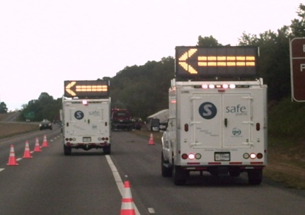
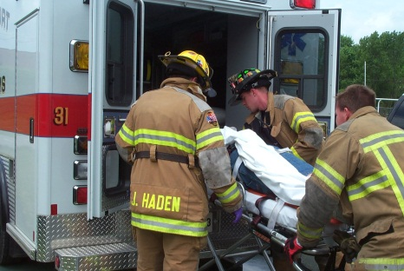
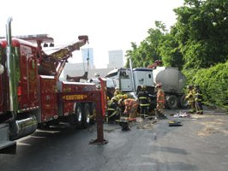
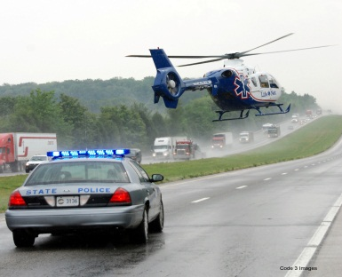
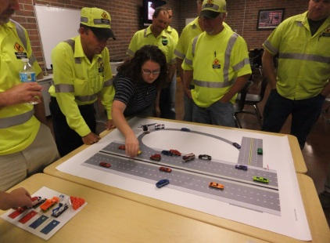
National Traffic Incident Management Responder Training Program
Training sessions conducted in Kentucky – 21
(August 5, 2013 – January 31, 2014)
Number of first responders trained – 523
Training Locations – Hopkinsville, Louisville (8), Bowling Green (2), Paducah, Hazard, Greenville, Winfield, Nancy (2), Lexington (2), Lawrenceburg (2), and Frankfort

Slide 22
Disciplines Trained | Number | Percent
Law Enforcement | 91 | 17%
Fire/Rescue | 131 | 25%
Towing & Recovery | 49 | 10%
EMS | 68 | 13%
DOT/Transportation | 131 | 25%
Other Disciplines | 53 | 10%
TOTAL | 523 | 100%

Slide 23
February 17, 2014 | Northern Kentucky ADD, Florence | 8am – 12pm & 1pm – 5pm
February 19, 2014 | Grant Co. Extension Office, Williamstown (KYTC) | 8:30am – 12:30pm
February 20, 2014 | Pendleton Co. Extension Office, Falmouth (KYTC) | 8:30am – 12:30pm
February 21, 2014 | Laurel Co. Extension Office, London | 5pm – 9pm
February 24, 2014 | Gallatin Co. Extension Office, Warsaw (KYTC) | 8:30am – 12:30pm
February 25, 2014 | Boone Co. Extension Office, Burlington (KYTC) | 8:30am – 12:30pm
March 17, 2014 | Trigg Co. Rescue Office, Cadiz (KYTC) | 6:30pm – 10:30pm
April 10, 2014 | EKU Stratton Building, Richmond | 8am – 12pm
April 10, 2014 | EKU Stratton Building, Richmond | 1pm – 5pm
May 14, 2014 | James Bruce Convention Center, Hopkinsville | 8am – 12pm
May 14, 2014 | James Bruce Convention Center, Hopkinsville | 1pm – 5pm
May 29, 2014 | Hart Co. Extension Office, Munfordville | 9am – 1pm
June 4 - 5, 2014 | Lifesavers Conference, Louisville | 2:30pm – 4:30pm
July 1, 2014 | Magoffin Co. Extension Office, Salyersville | 5pm - 9pm

Slide 24
Construction Updates
I-65 Cave City – Horse Cave
I-65 Horse Cave – Munfordville
Nunn Parkway / Glasgow Outer Loop
Nunn Parkway / Edmonton US 68 interchange

Slide 25
2014 - Meetings
Involving all IM Team members and interests
Interest in other team agencies co-hosting?
  KSP
  County SO,
  KYEM, County EM,
  Towing / recovery,
  KY DEP – Emergency Response
Outside subject matter experts or presentations?

Slide 26
2014 IM Team Goals
OUR TEAM –
OUR CHALLENGE
IM Team Mission Statement
Your agencies role in TIM
Please respond to the questionaire you will receive by e-mail

Slide 27
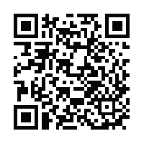
Next Meeting
Tuesday May 6th 9 am
Presentations & other D-3 IM Team files can be found at
http://transportation.ky.gov/District-3/Pages/TIM.aspx
Jon Lam
District 3 IM Coordinator
Office 270-746-7898 xt 225
Cell 270-392-8760 or 270-784-8570
Jon.lam@ky.gov

